Slide 1


AI SME
Your context-aware knowledge Aasistant

Slide 2

THE PROBLEM WE ARE SOLVING
Today’s Challenges
  Critical technical knowledge is spread across multiple systems
    Confluence pages
    GitHub repositories
    Internal documents
    SME tribal knowledge
  Engineers and support teams spend significant time searching instead of solving
  Answers depend heavily on who you ask, leading to:
    Inconsistent responses
    Knowledge silos
    SME dependency and burnout
Impact
  Slower problem resolution
  Repeated questions to SMEs
  Increased onboarding time for new engineers
  Operational inefficiency at scale

Slide 3
WHY SOLVING THIS MATTERS
If We Fix This Problem
We unlock measurable business value:
  Faster time-to-answer
    Reduce minutes/hours of searching to seconds
  Reduced SME load
    SMEs focus on complex issues, not repeated questions
  Consistent, approved answers
    One source of truth across teams
  Improved onboarding
    New engineers ramp up faster
  Better operational resilience
    Knowledge survives team changes and attrition

Slide 4
HOW OUR IMPLEMENTATION SOLVES THE PROBLEM
End-to-End Flow ( High level)
  Internal documents (Confluence, GitHub, uploads) are indexed
  Content is:
    Cleaned
    Chunked
    Converted into semantic embeddings
    Stored in a vector DB
  User asks a question in natural language
  System:
    Finds the most relevant internal content
    Uses an LLM to generate a grounded response
  Answer is returned with context and traceability
Result
  Accurate, explainable, enterprise-ready answers

Slide 5
ARCHITECTURE
This architecture enables a secure, enterprise-ready AI assistant that answers questions using internal documentation instead of generic internet knowledge.
  Frontend (Browser)
    Web UI with Chat and Document Upload
    Google Sign-In for authentication
    Maintains session state (user, conversations)
  Backend APIs
    Auth API issues JWT after identity verification
    Chat API handles queries and streaming responses
    Document API processes and indexes uploaded content
  RAG Intelligence Layer
    Retriever searches internal knowledge using vector embeddings
    Generator produces answers grounded in retrieved context
    Prevents hallucinations by design
  Storage
    PostgreSQL for users and chat history
    ChromaDB for semantic search over documents
  Authentication & Security
    Google OAuth for user identity
    JWT-based authorization
    Auth Guard protects all backend endpoints
  External Services
    OpenAI for embeddings and response generation
    Google OAuth for authentication

Slide 6
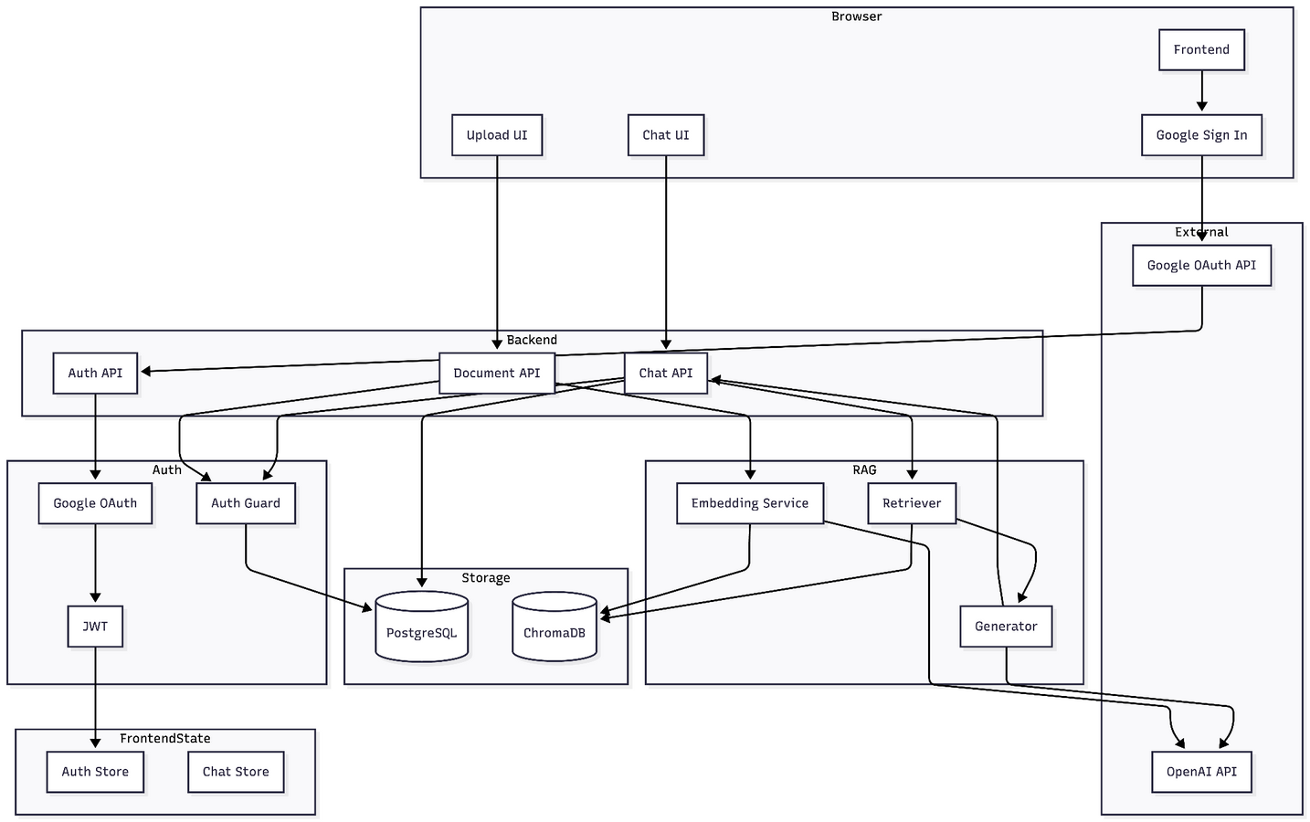
ARCHITECTURE

Slide 7
WHY THIS IS SAFE FOR AN ENTERPRISE BANK
Risk & Compliance Considerations
  No training on external data
  No uncontrolled internet browsing
  Retrieval limited to approved internal content
  Auditability via:
    Source metadata
    Conversation history
  Can be extended to:
    Logging & monitoring

Slide 8
LIMITATIONS
Current Limitations:
1. Knowledge Base Scope Only answers questions about indexed documentation/code. If information isn't in the knowledge base, it can't answer.
2. Code Execution: Can't run code or test solutions—only provides information and examples.
3. Real-Time Data: Doesn't have access to live system metrics, logs, or real-time data.
4. Multi-Modal: Can't process images, diagrams, or screenshots (text-only).
5. Complex Reasoning: May struggle with multi-step problem-solving that requires deep code analysis.

Slide 9
REALISTIC FUTURE SCOPE
Short-Term Enhancements
  Better source citations
  Admin UI for content control
  Adding live tracking using splunk and Mongodb
Mid-Term
  Integration with:
    ServiceNow
    Incident management systems
Long-Term Vision
  AI SME per team
  Cross-domain reasoning
  Predictive insights from operational data

Slide 10
Thank you.

